Slide 1
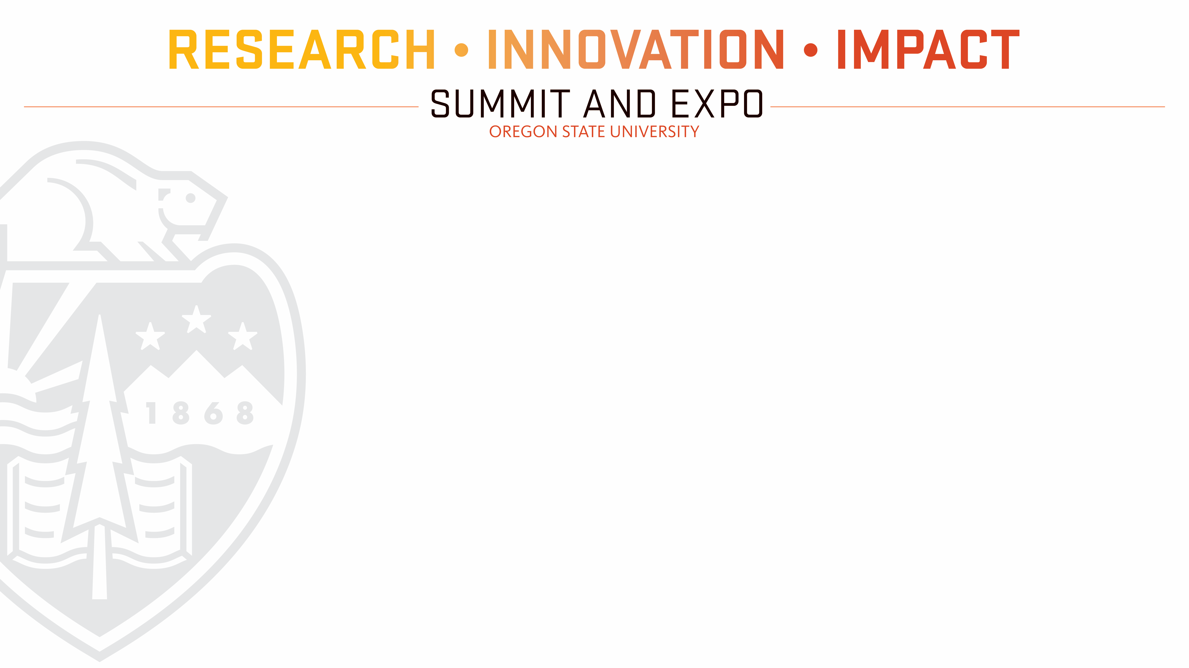
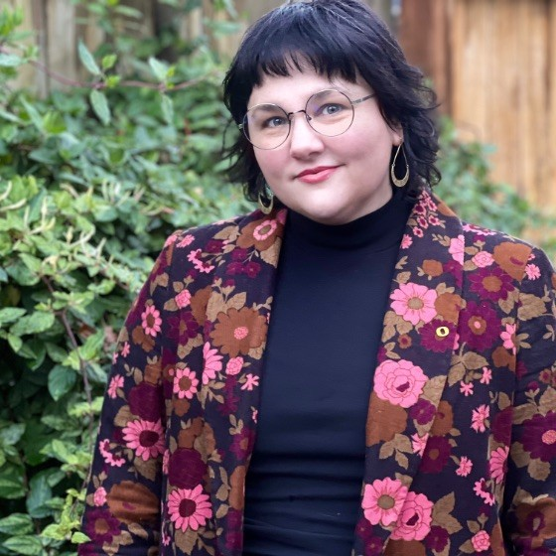
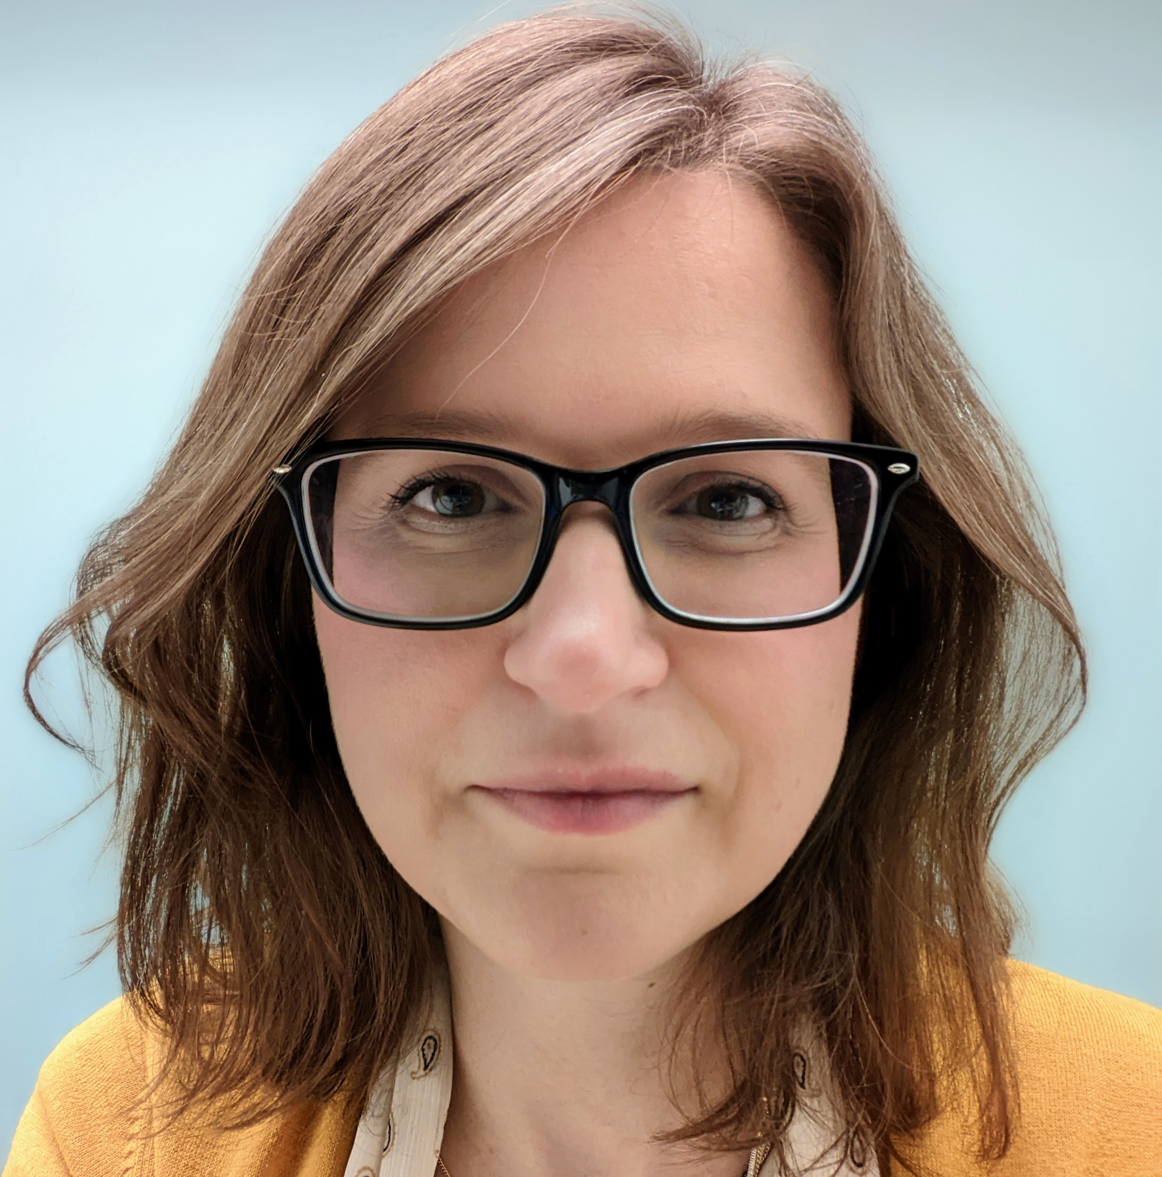
PRIVATE FOUNDATIONS:
An Engine for Big Ideas
Presented by OSU Foundation’s
Office of Foundation Relations
Mackenzie Karp
Senior Director
Elizabeth Ocampo
Director
Notes:
Hi, welcome. We’re so glad you’ve joined us.
Our topic today is about private foundations and how they catalyze and support big ideas through philanthropy.
My name is Elizabeth. I’ve served on the Foundation Relations team for 8 years, supporting faculty and programs who are pursuing external funding from philanthropic organizations.
And I’m Mackenzie. I’ve been leading this team for about a year.

Slide 2
PRIVATE FOUNDATIONS:
An Engine for Big Ideas
Private Foundation Introduction
Thinking Big Exercise
Philanthropist Mindset
The Office of Foundation Relations
Agenda:

Slide 3
















Private Foundations
What are they?
What do they support?
Notes:
We’re going to begin by setting up some context about what these organizations are and what they do.
The image on the right side of the slide includes logos from organizations that have supported Oregon State University. Some of these are among the largest private foundations in the country, some are concentrated just in Oregon or the Pacific Northwest. They have supported a wide variety of research, topics, and programs at OSU, from health to basic science, from graduate student support to industry commercialization, as well as the arts and humanities. Every one of these foundations is currently interested in supporting big ideas. Let’s talk a bit more about what that means.

Slide 4
Non-profit, tax-exempt organizations that are required to distribute assets for charitable purposes.
Mission-driven activities.
Idiosyncratic processes.
Tackling intractable social problems that require big ideas to solve.
​
Private Foundations
Notes:
Private foundations exist for altruistic purposes. They are required by law to distribute funds to support charitable purposes.
Foundations are allowed to set up their own governing systems, but there are some standardized themes. They all have boards that make decisions, and most have a mission that drives activities, including what types of charitable purposes the organization supports.
Right now, the foundation sector is especially concerned with funding projects and programs that are tackling intractable social problems (such as climate change, healthcare, and childhood poverty, for example) with the kinds of big ideas that can disrupt entrenched systems and catalyze new solutions.

Slide 5
Private Foundations
Charitable Purpose
Big Idea
Mission
Non-profit, tax-exempt organizations that are required to distribute assets for charitable purposes.
Mission-driven operating procedures.
Tackling intractable social problems that require big ideas to solve.
Notes:
Nonprofits and charities do a lot of great work, but an individual organization’s mission will narrow the scope of effort. The big ideas the organization supports fit within the mission. Sometimes one organization supports more than one big idea topic, all of which still fall within the mission.
The work of identifying potential private foundation partners involves connecting that funder’s specific mission to the work of solving a social problem. Common rejection feedback might say the idea is wonderful, and the work is valuable and important, but it’s just outside the organization’s mission.

Slide 6
Private Foundations
NSF
NIH
USDA
Big Idea
Private foundations prefer to support projects that need a champion, projects where other funding may be unavailable or difficult to access.
Notes:
Foundations look for brilliant ideas that may fall into gaps or just outside the reach of larger agencies or funding sources. Again, big idea = innovative solutions that disrupt entrenched systems and catalyze transformation (aka systemic change)

Slide 7

Discussion
Connecting your work
Notes:
We’re going to try our hand at thinking big. This is exactly the kind of thought exercise these foundations hope to initiate with their calls.

Slide 8
Discussion
How does your work connect to a big societal problem?
What audacious way might you tackle the problem?
In an ideal world, what team would you need? What stakeholders should be included?
How much time would you need? What resources would you need to acquire?
Notes:
With the person or people next to you, we want you to share how what you work on is connected to a big societal problem. What is that problem, and how does what you do connect?
Then, if time, money, or other resources weren’t an issue, how would you go about solving the problem. I’ll invite you to start from the vantage point of your own expertise. Maybe what you do now is already pretty audacious. If so, that’s great! You can talk about that. If not, try reaching past what you can do with what you have now, and think about what you would want to try if you thought really big. Which of your ideas needs a champion?
Share your ideas with one another. Afterward, we’ll share with the room.

Slide 9
Discussion
Look around the room!
What themes emerge among the connections on societal problems?
Who is working on similar problems to your own?
Who has big plans that you could plug into?

Slide 10

Philanthropy and the
Innovation
Economy
A new mindset for social benefit

Slide 11
Philanthropy and the
Innovation Economy
Year | Organization
1964 | David and Lucile Packard Foundation
1966 | William and Flora Hewlett Foundation
1999 | Michael & Susan Dell Foundation
2000 | Bill & Melinda Gates Foundation
2000 | Gordon & Betty Moore Foundation
2004 | Omidyar Network
2006 | Schmidt Family Foundation
2011 | Emerson Collective (Laurene Powell Jobs)
2011 | Good Ventures
2014 | Open Philanthropy Project
2015 | Ballmer Group
2015 | Chan Zuckerberg Initiative
2015 | Pivotal Ventures (Melinda French Gates)
2020 | Bezos Earth Fund
2022 | Yield Giving (MacKenzie Scott)
2023 | Jen-Hsun and Lori Huang Foundation
2024 | Coefficient Giving
Philanthropic trendsetters have emerged from Silicon Valley tech startups and venture capital.
These corporations found success through innovation and disruption.
Notes:
Business lessons have long been applied to the philanthropic organizations led by the people who founded them. Right now, the tech industry is significantly influencing how the philanthropic sector prioritizes the projects they support.
Innovation and disruption were valuable attributes in the businesses that changed how the world communicates and works. Could they also be valuable attributes in how we solve societal problems?
These funders are

Slide 12
Philanthropy and the
Innovation Economy
The lessons of success in the innovation economy are being applied to philanthropic problems.
Impact as Return on Investment
  Harnessing Unique Assets
Innovation
  Transformational/Disruptive
Cross-Functional Solutions
  Transdisciplinary
Urgency Prioritization
Notes:
Impactful – Who benefits, how much, and how will you measure that benefit? In philanthropy, ROI isn’t profit-based; it's the amount of measurable social good a project can accomplish relative to its cost. **The potential impact should match the aims of the sponsor and of the specific call. Ideally, the impact you describe helps chip away at the kinds of intractable social challenges that need visionary solutions. Think big!
Harnesses Unique Assets – Why is this project resourced in a way that competing proposals are not? What unique assets increase the value of the inputs, and then, by extension, the value of the project’s return?
Innovative – Think about innovation comparatively. What is different about the project compared with what peers are doing? Particular value for innovations that are transformational and disruptive. What about your approach represents a leap forward (not the next logical step), or coming from an unexpected direction?
Cross-Functional Solutions – How can the team combine expertise and experience to achieve what's unachievable alone? How do their disciplines, sectors, and experiences position them to do the proposed work? Transdisciplinary = combines more than one discipline, more than one sector (academic + [industry/nonprofit/public]), and community/client/beneficiary involvement.
Urgent/Timely – Why does this have to happen right now? What about this moment requires immediate intervention?

Slide 13
Example: Coefficient Giving’s Launchpad Funds
Coefficient Giving is accepting expressions of interest (EOIs) for Launchpad Funds: new or scalable funds tackling important, underfunded problems in global health and wellbeing.
We are seeking EOIs in two tracks: (1) pre-seed funding of $200k–$10m over up to 24 months, and (2) seed and scaling funding of $10m–$50m+ over up to 36 months. In both tracks, we’ll weigh how our funding would be used directly as well as the fund’s potential to attract and cost-effectively deploy $100m+ from other funders over the next several years. We expect to make at least 10 pre-seed grants and at least 3 seed and scaling grants, with the possibility of making significantly more in each track if there are promising opportunities.
This RFP closed on October 2, 2026. We are no longer accepting applications.
This call from Coefficient Giving (founded by Dustin Moskovitz, co-founder of Facebook and Asana)
Impact – 1,000x ROI multiplier = every dollar should create as much value as $1,000 for someone earning $50K/year.
Innovation – severe problem that is underfunded relative to its importance.
Team - the individual or team behind the proposal has the track record, judgment, and network required to achieve the targeted outcome.
Notes:
This call from Coefficient Giving just ended, but it is a good example of the kinds of proposals being produced with an “innovation economy” mindset.

Slide 14
Example:
Burroughs Wellcome Fund’s Next Gen Pregnancy (NGP) Initiative
NGP is a highly competitive program that provides $700,000 in support over four years for scientists who are committed to an academic career in pregnancy research.
The NGP program aims to fund innovative basic science research, with high-risk/high-reward projects focused on the following priority areas:
Mechanisms of healthy pregnancy (e.g., normal physiology and biological underpinnings of healthy pregnancy).
Preterm birth.
Pregnancy loss (after 12 weeks) and recurrent pregnancy loss.
Pre-eclampsia.
These conditions remain both pervasive challenges in reproductive medicine and persistently underexplored in reproductive biology.
Application deadline: November 17, 2026
Selection Process includes:
Innovation – creative, original approach; high-risk/high-reward; transforms basic understanding.
Impact – both short- and long-term potential impact on the state of science and standards of clinical care.
Team – transdisciplinary teams that bridge boundaries and integrate diverse knowledge, expertise, and experiences.
Notes:
Here’s an example from outside the tech philanthropy landscape that shows how these trends extend across the sector.
History: Silas Burroughs and Henry Wellcome were pharmacists who launched their London-based business in 1880. In 1955, the Burroughs Wellcome Fund was established as a corporate foundation for the company’s U.S. branch (later acquired by GlaxoSmithKline), and in 1993, it became a fully independent private foundation.
This call is also an example of a basic science call for big ideas to address intractable societal problems. Not all of these requests are looking for applied solutions.
See themes we’ve discussed:
The topic needs a champion! Pervasive challenges that are persistently unexplored
Innovation: the requirement is finding creative, original approaches – not the next logical step, but something risky that potentially transforms understanding
Impact: ROI = high reward to both the state of science understanding and its downstream applications
Team: transdisciplinary!

Slide 15
Philanthropy and the
Innovation Economy
Good Fit
Not a Good Fit
Innovative, big ideas
High ROI
Requires diverse knowledge and expertise to implement
A problem requiring immediate intervention
A problem seeking a visionary partner to champion
Next logical step in a research plan
Unmeasurable or underwhelming impact-to-cost ratio
Single-domain and/or single-sector
Not urgently needed
A popular problem with lots of supporters or a well-funded supporter

Slide 16
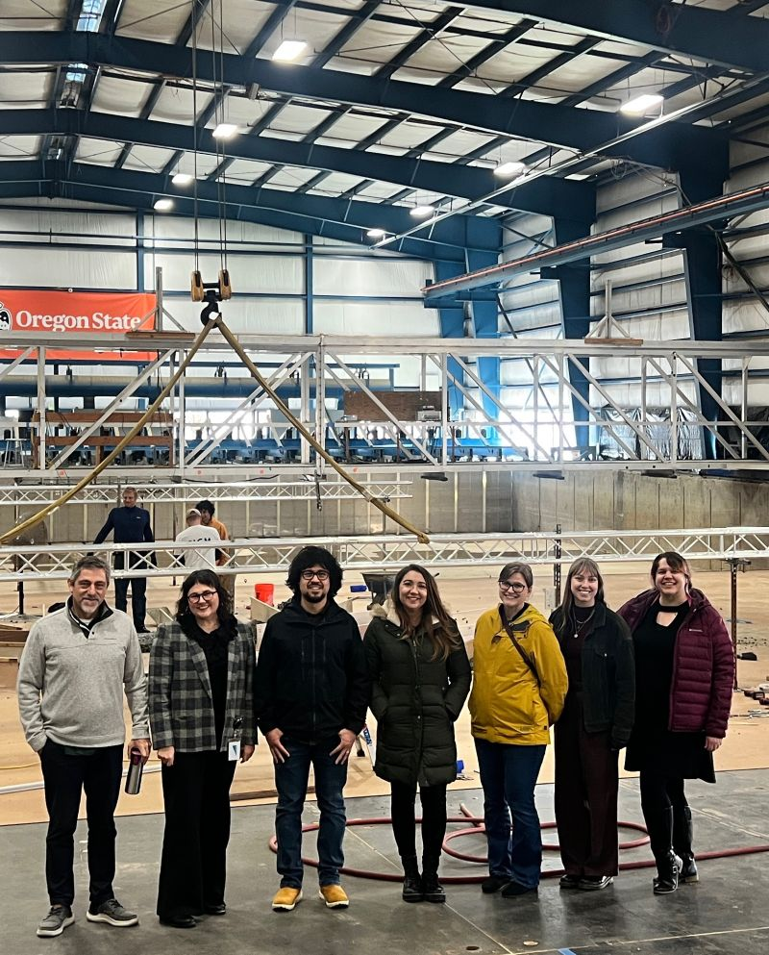

Office of
Foundation
Relations
Notes:
The OSU Foundation works closely with partners across the university to support faculty programs that are pursuing external funding from foundations.
This is us! We’re at the Hinsdale Wave Lab.

Slide 17
Foundation Relations
Based at the OSU Foundation, the FR team works closely with partners across the university.
University Leadership
Division of Research and Innovation
OSRAA
Colleges, ADRs, and unit preproposal staff
Individual Faculty
Notes:
Our collaborative network extends all the way from leadership to the PI level

Slide 18
Foundation Relations
OSU Funding Ecosystem
OSU Foundation
Foundation Relations
College Development Officers
Colleges – Leadership and Faculty
Unit-Based Award Staff
Division of Research and Innovation
OSRAA
Office of Research Advancement

Slide 19
Foundation Relations Services
Strategic project alignment, prospect research, vetting
Relationship development with private foundations
Proposal review, editing, and submission
Post-award report support
Training for proposal development and engaging with private grant makers

Slide 20
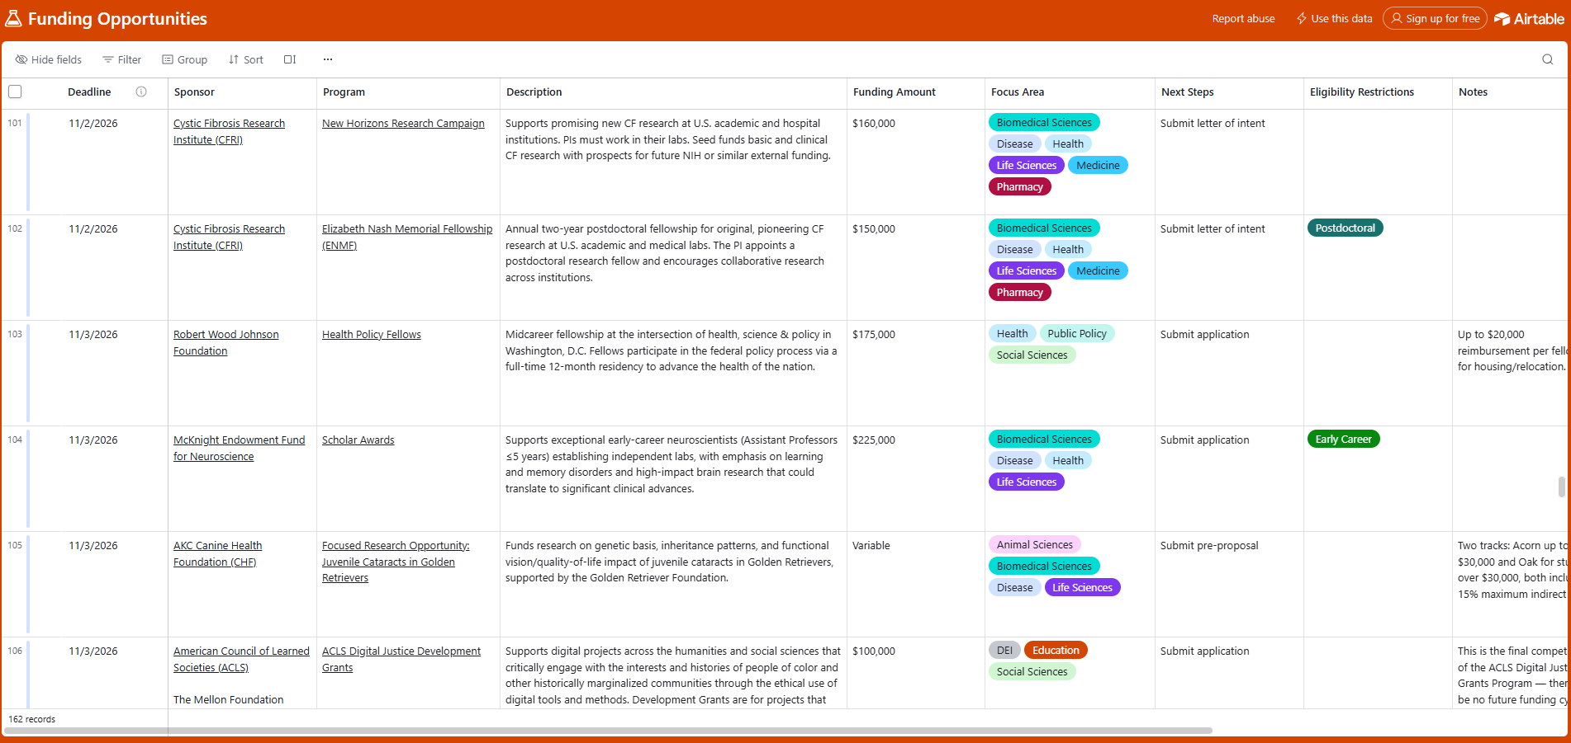
Foundation Relations Services
🌟NEW!!🌟
Notes:
New from FR! Our Funding Opportunities list has undergone a makeover this summer. It is still available on our website, fororegonstate.org, but is now also available via an Airtable subscription. Have the list emailed to you with added user controls to sort and filter by deadline, sponsor, amount, focus areas, and eligibility restrictions.

Slide 21
Private Foundations:
An Engine for Big Ideas
Connect your work to a pervasive societal challenge
Discover funders who care about the kinds of work you do
Strategize fit within an organization’s mission
Build teams and networks to carry out an audacious vision
Communicate innovation and impact
Notes:
How can Foundation Relations help you? When it comes to private foundation funding and big ideas, we can help you with every step along the way, from ideation to crafting a submission to post-award communication.

Slide 22
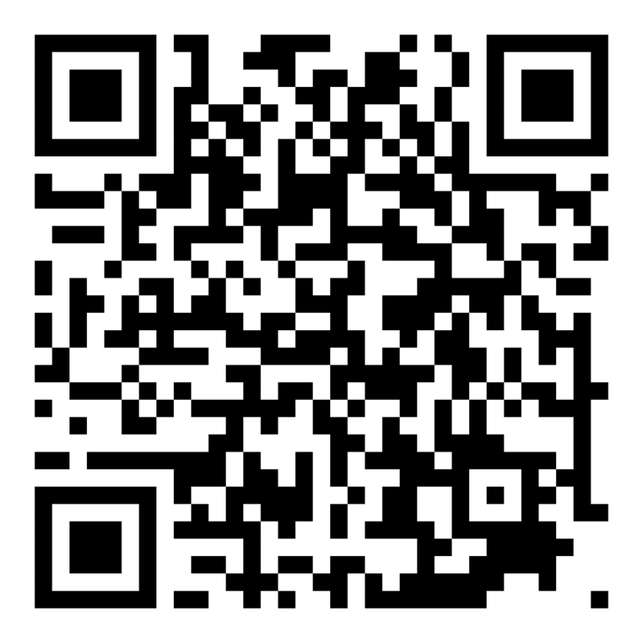
CONTACT US
Email the team:
Foundation.Relations@OSUFoundation.org
www.fororegonstate.org/foundationrelations
Notes:
Thank you!

